Slide 1
VUV and EUV irradiation of CH₄ + NH₃ ice mixtures
Lily Leung

Slide 2
Contents
Introduction
Production mechanism of CN⁻
Deposition rate of methane on Charon
Surface temperatures at different latitudes
Ammonia on Organa Crater
Methodology
Experimental setup
Energy source
Experimentsl Configurations
Results
Production mechanism of CN⁻
The relations between CN⁻ and C₂H₆
CN⁻ formation efficiency of EUV (40.1 eV) and VUV (9.27 eV)
Astrophysical Implications
Understand CN⁻ formation on Charon

Slide 3
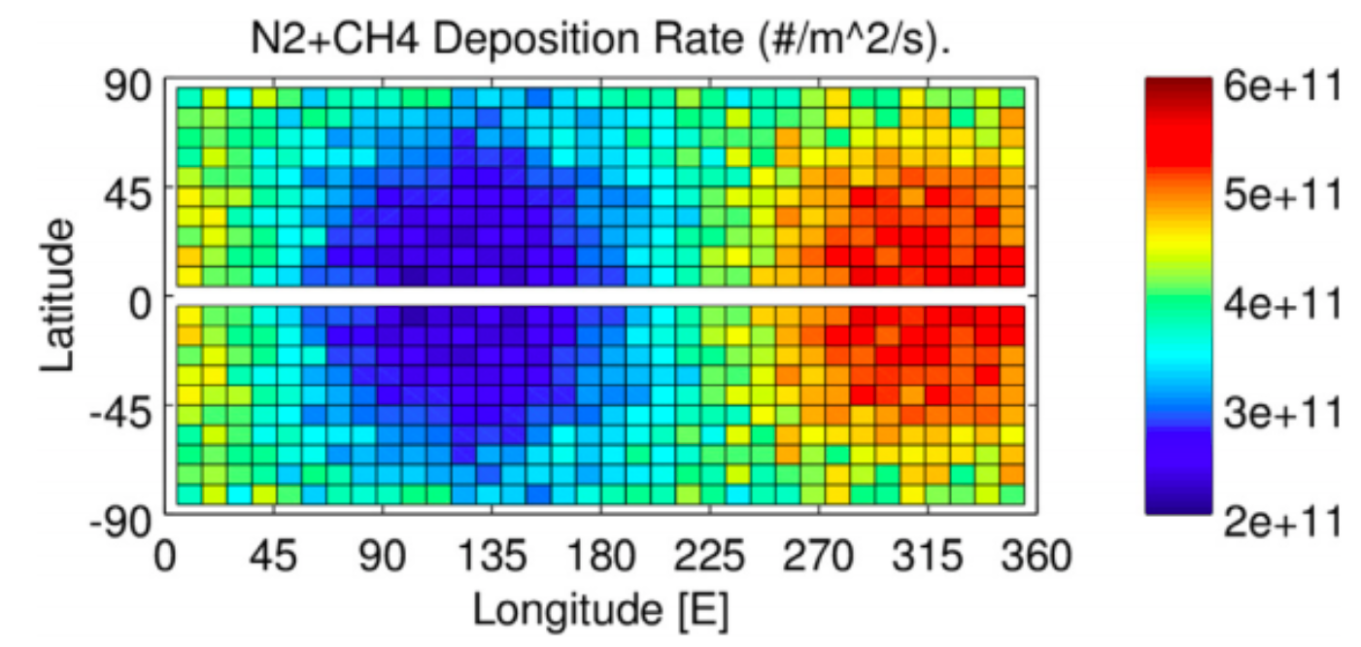
Introduction
Variation of methane on Charon
quoted from Hoey et al. (2017)

Slide 4
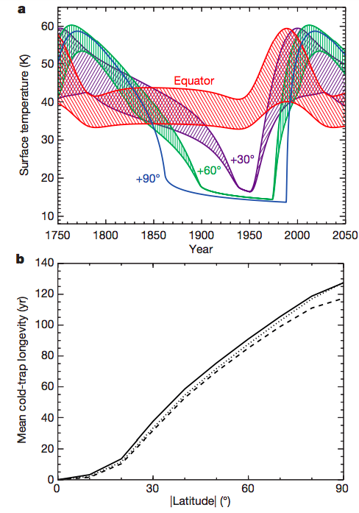
Introduction
Thermal model from Grundy et al. (2016) shown as a shows the pole positions are below 25 K for 130 years
Methane can condense on those position where the temperature is below 20 K(solid state).
Quoted from Grundy et al. (2016)

Slide 5
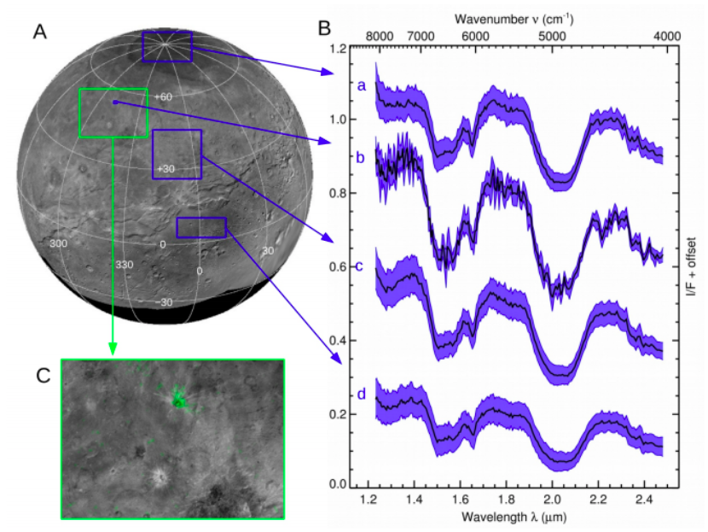
Introduction
Ammonia was detected all over the surfaces, especially on Organa crater
from Grundy et al. (2016)

Slide 6
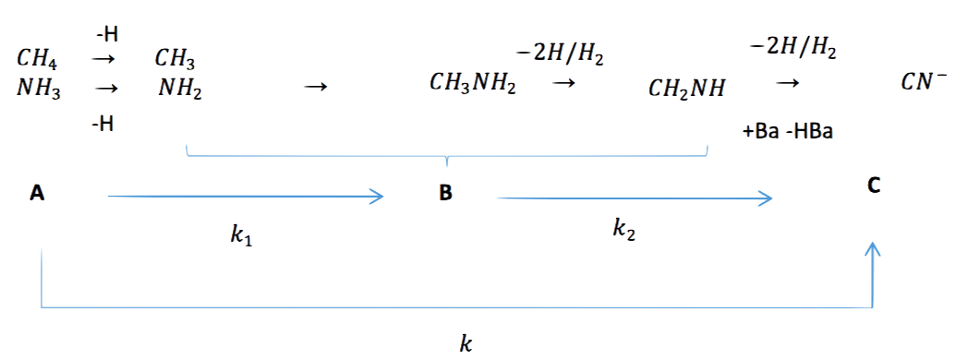
Introduction
Investigate the mechanism of CN⁻:
Quoted from Kim and Kaiser (2011)

Slide 7
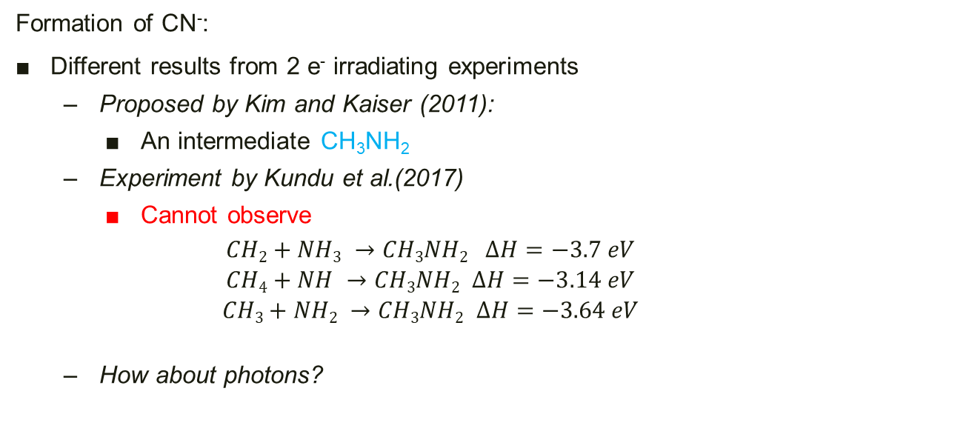
Introduction
Formation of CN⁻:
Different results from 2 e⁻ irradiating experiments
Proposed by Kim and Kaiser (2011):
An intermediate CH₃NH₂
Experiment by Kundu et al.(2017)
Cannot observe
$$CH2+NH3 →CH3NH2 ∆H=−3.7 eV$$
$$CH4+NH →CH3NH2 ∆H=−3.14 eV$$
$$CH3+NH2 →CH3NH2 ∆H=−3.64 eV$$
How about photons?

Slide 8
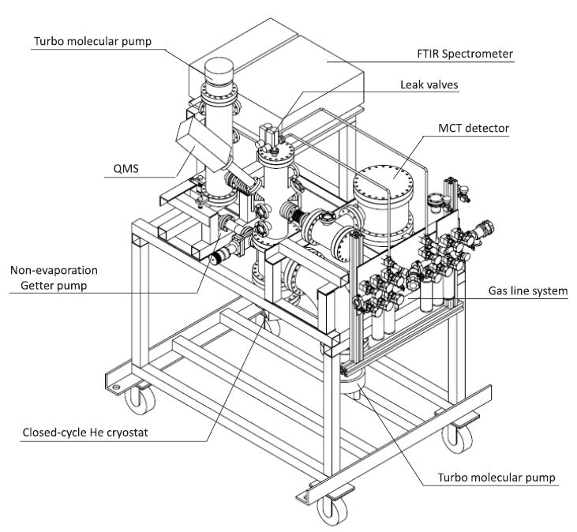
Methodology
IR path
VUV/EUV path
Quoted from Chen et al. (2014)

Slide 9
Methodology
Infra-red
Cool system to 15 K (1 x 10 ⁻¹⁰ torr) from 300 K ( 8 x 10 ⁻¹⁰ torr)
QMS
Deposite the ice mixtures with partial pressure ~ ratio of ice
EUV/VUV
Irradiate the samples
KBr substrate
Warm-up with 1 K/min

Slide 10
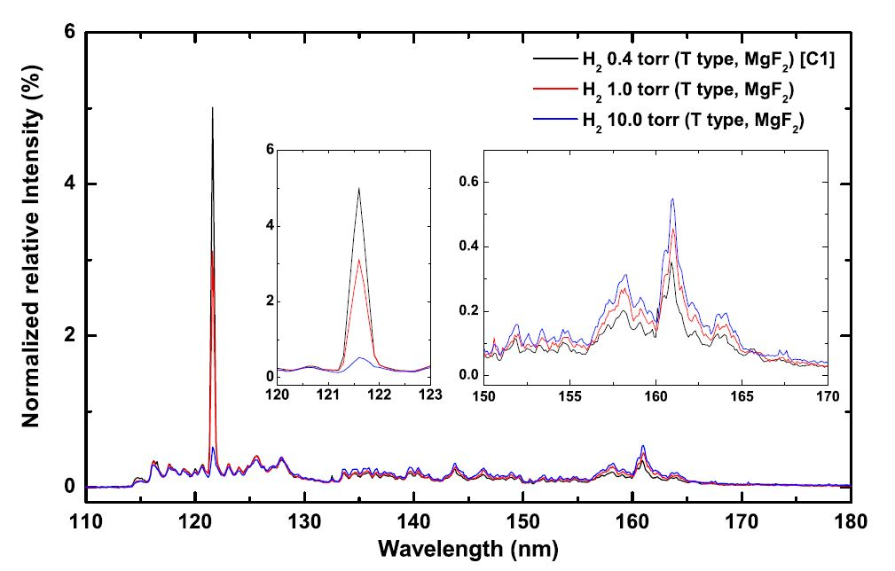
VUV (MDHL)

Slide 11
Methodology
Energy source and configurations
Energetic Source | species | Thickness of CH4+NH3 ice mixtures (ML)
 |  | 3:2 | 1:5 | 1:10 | 1:20
VUV (MDHL) | CH₄ | 900 | 120 | 60 | 30
 | NH₃ | 600 | 600 | 600 | 600
EUV (30.4 nm) | CH₄ | 900 | 120
 | NH₃ | 600 | 600

Slide 12
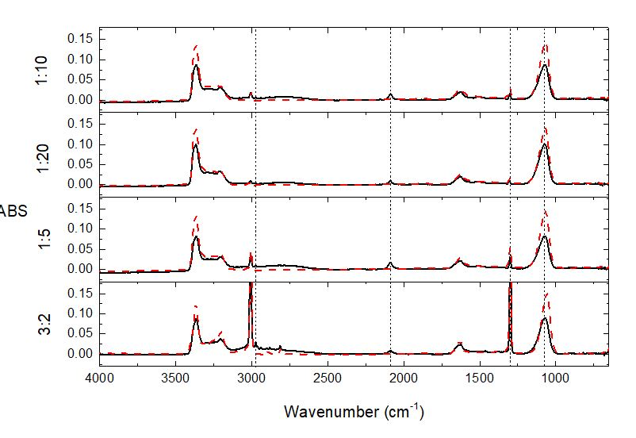
Results
These are VUV irradiated infra-red spectrum, with dotted lines prior to irradiation
CN⁻ C₂H₆ and C₃H₈ are formed
C₂H₆
CN⁻
NH₃
CH₄

Slide 13
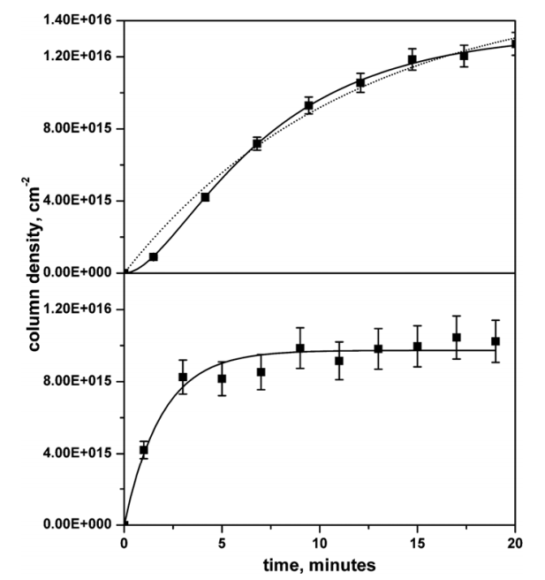
1. Production mechanism of CN⁻
2 step/1 step?

Slide 14
1. Production mechanism of CN⁻
2 step/1 step?

Slide 15
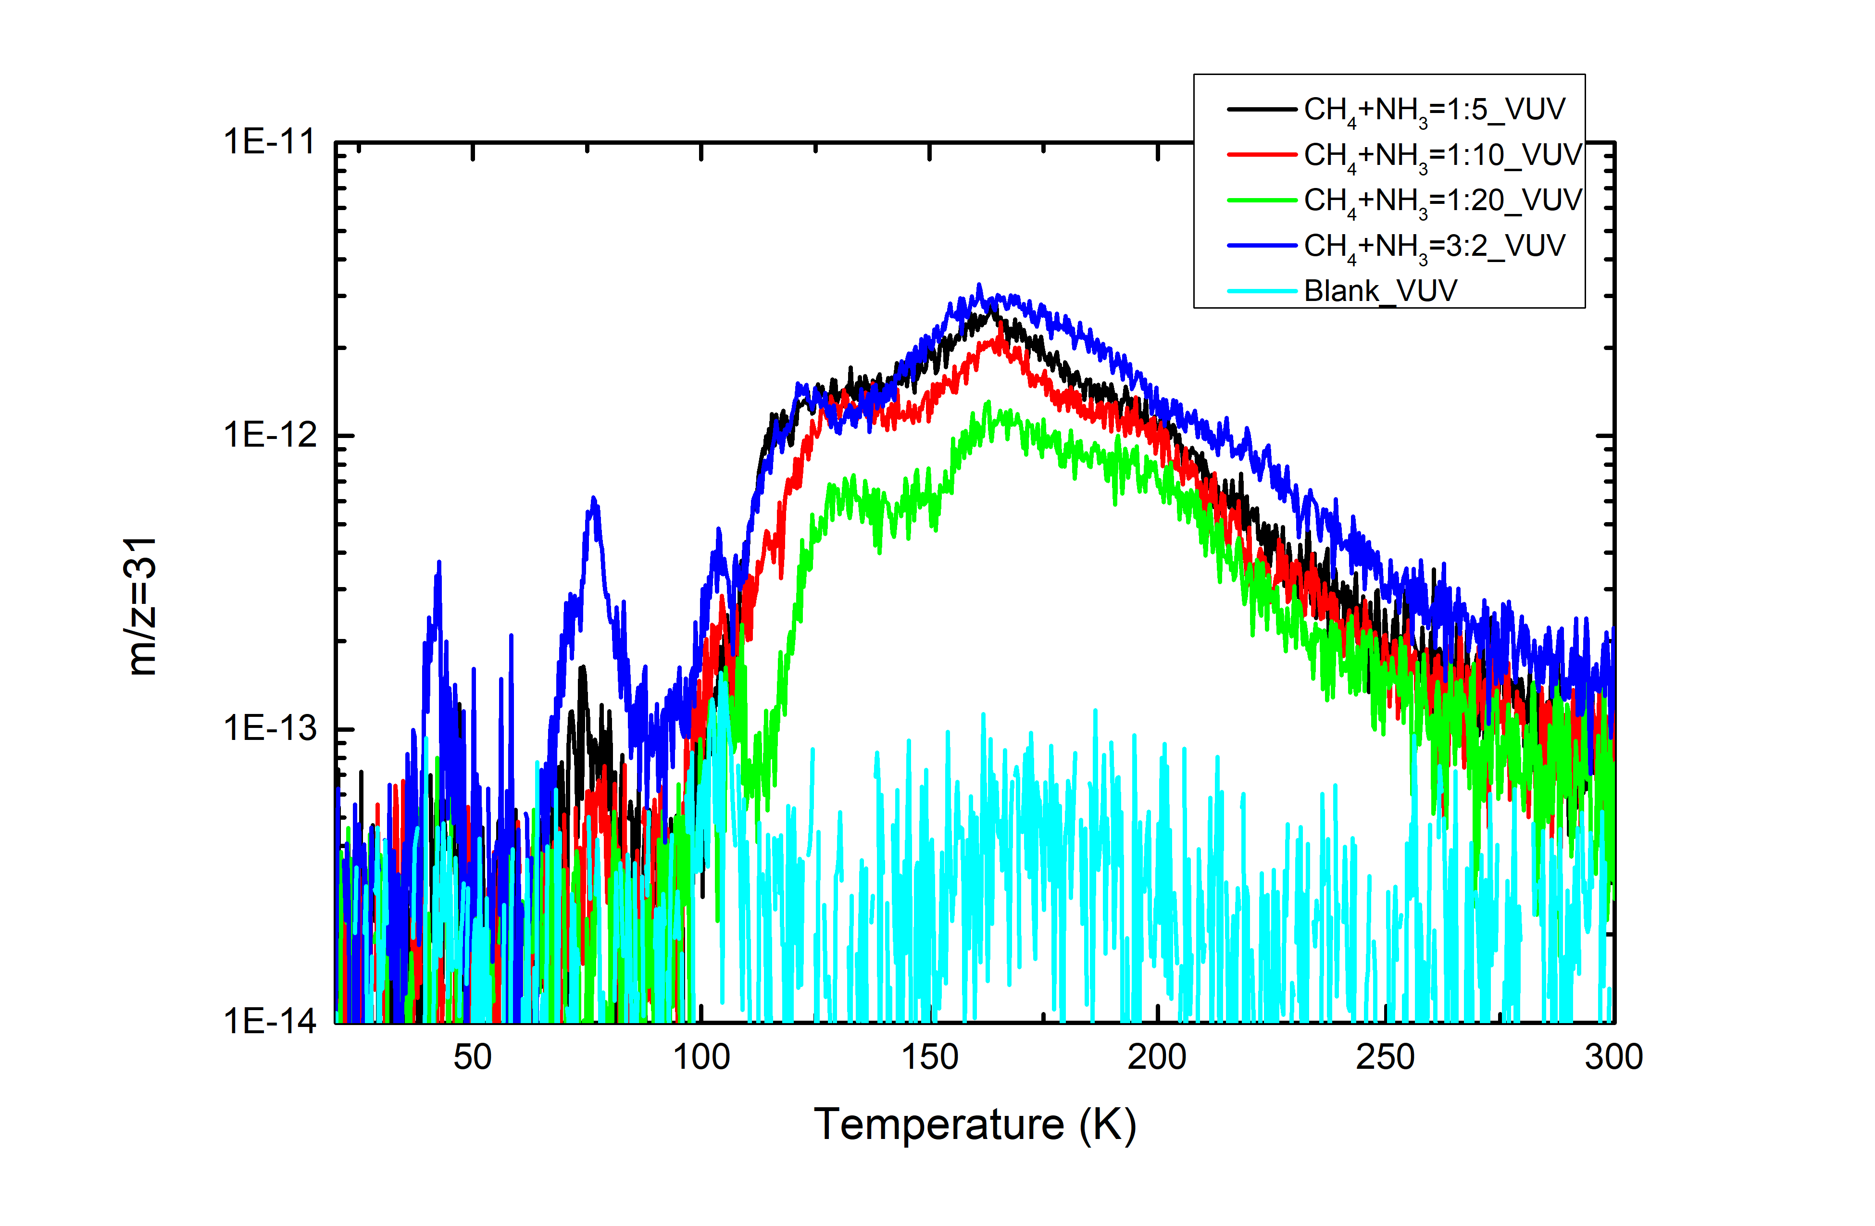
1. Production mechanism of CN⁻
Methylamine (CH₃NH₂) with m/z=31 is detected by QMS after isothermal VUV irradiation during warm-up which is the intermediate of the CN⁻

Slide 16
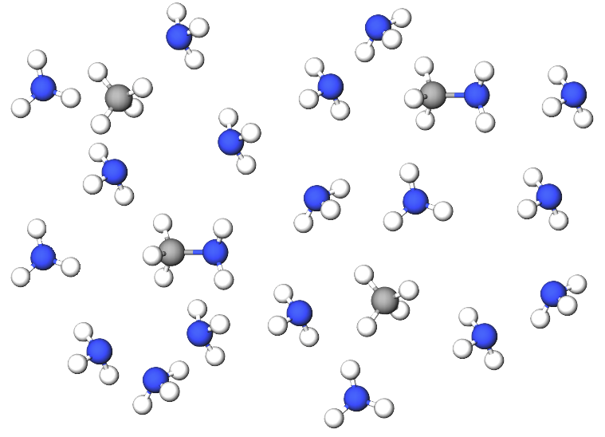
2. The relations between CN⁻ and C₂H₆ during VUV irradiations
figure 3. A demonstrating diagram of CH₄+NH₃ = 1:5

Slide 17
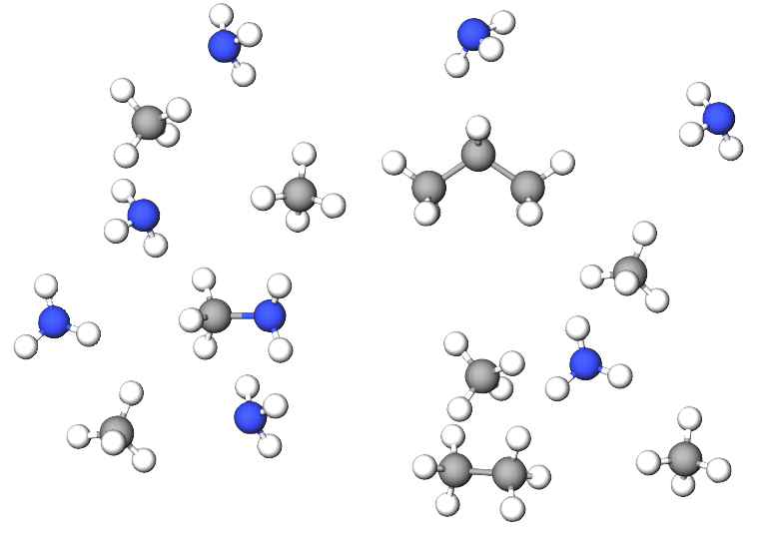
2. The relations between CN⁻ and C₂H₆ during VUV irradiations
figure 4. A demonstrating diagram of CH₄+NH₃ = 3:2

Slide 18
2. The relations between CN⁻ and C₂H₆ during VUV irradiations
Ratio of CH₄+NH₃ | C₂H₆ (ML) | CN⁻ (ML)
3:2 | 19.1 | 23
1:5 | 4.3 | 49

Slide 19
3. Efficiency of EUV (40.1 eV) and VUV (9.27 eV)
Radicals species | CH₄ | NH₃
- 1 H | 4.55 eV | 4.67 eV
-2 H | 4.78 eV | 4.38 eV
-3 H | 9.19 eV | 7.63 eV

Slide 20
3. CN⁻ formation efficiency of EUV (40.1 eV) and VUV (9.27 eV)
Fitting with y = Ae^{-kx} + C (pseudo first order kinetics)
CH₄ NH₃

Slide 21
3. CN⁻ formation efficiency of EUV (40.1 eV) and VUV (9.27 eV)
k (photons ⁻¹) | CH₄(x 10⁻¹⁸) | NH₃ (x10⁻¹⁸)
VUV (MDHL) | 3.70±0.18 | 2.89±0.10
EUV (30.4nm) | 0.61±0.03 | 0.91±0.11
Destruction cross-section ratio | 6.06±0.07 | 3.18±0.12
k (photon ⁻¹) | CH₄ to NH₃ 3:2 (x 10⁻¹⁸) | CH₄ to NH₃ 1:5 (x10⁻¹⁸)
VUV (MDHL) | 8.21±0.70 | 1.93±0.19
EUV (30.4nm) | 1.92±1.99 | 0.63±0.37
CN- production ratio | 4.28 | 3.06

Slide 22
Astrophysical implications
Ly α is the main energy source to produce CN⁻ on Charon
3.06 to 4.28 times more efficient by VUV then EUV
VUV flux is 1 order of magnitude more intense than EUV irradiations (Grundy et al. 2016)
Ly α exposure: 1.9 x 10⁹ eV cm⁻² s⁻¹
EUV exposure: 8.7 x 10⁷ eV cm⁻² s⁻¹

Slide 23
Astrophysical implications
Surface composition after 1 Pluto winter:
Ly α exposure: 1.9 x 10⁹ eV cm⁻² s⁻¹ (Grundy et al. 2016)
= photon dose 7.64x 10 ¹⁷ photons cm⁻²
CH₄ deposition rate: 2-6 x 10⁷ cm⁻² s⁻¹ (Hoey et al. 2017
= 82-246 ML in 130 earth years
CH₄+NH₃ | CN⁻ (ML)
1:5 | 36.6
1:10 | 29.5
1:20 | 18.9
3:2 | 22.5

Slide 24
Conclusion
1. Confirms the formation mechanism of CN⁻ is via methylamine in photon irradiation experiments.
2. Concentration of CN⁻ is not proportional to initial CH₄ when CH₄ is in excess.
3. The reduced destruction cross-section of EUV 30.4nm irradiation is the main factor of slowing the rate of formations.
4. The maximum amount of CN⁻ after Charon winter is simulated experimentally.

